Slide 1
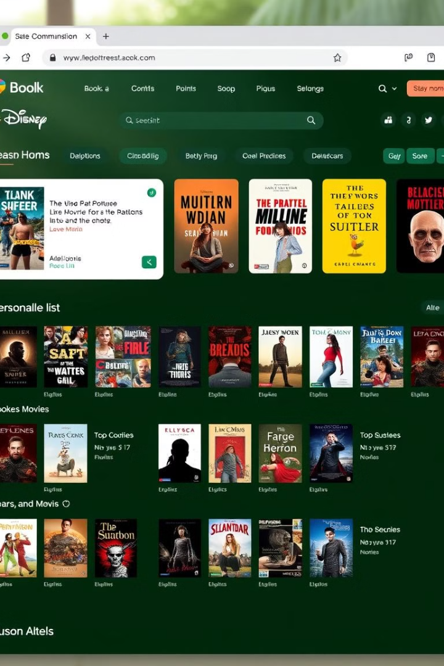
Syntra FXT GroepsWerk 2025: Personalized Wish/Watch-List Web Application
This presentation outlines the development of a web application designed for users to create personalized wish/watch-lists for books and movies. The application enables users to add, edit, and remove items seamlessly, enhancing their planning and tracking experience.
Beyond basic list management, the app integrates calculations such as the average number of pages per book and the percentage of the list completed. These features offer users a tangible sense of progress and engagement with their chosen media.

Slide 2




Team Roles and Specializations
Timothy: UI Design
Xander: Data Layer & Objects
Felix: Logic Layer
Focused on designing and implementing the User Interface (UI) to ensure the application is visually appealing and user-friendly.
Built the Data Layer and Database structure, ensuring smooth data storage and retrieval, while also designing the Objects that the application uses.
Developed the Logic Layer, which handles calculations, business rules, and any complex functionality that sits between the UI and data.

Slide 3
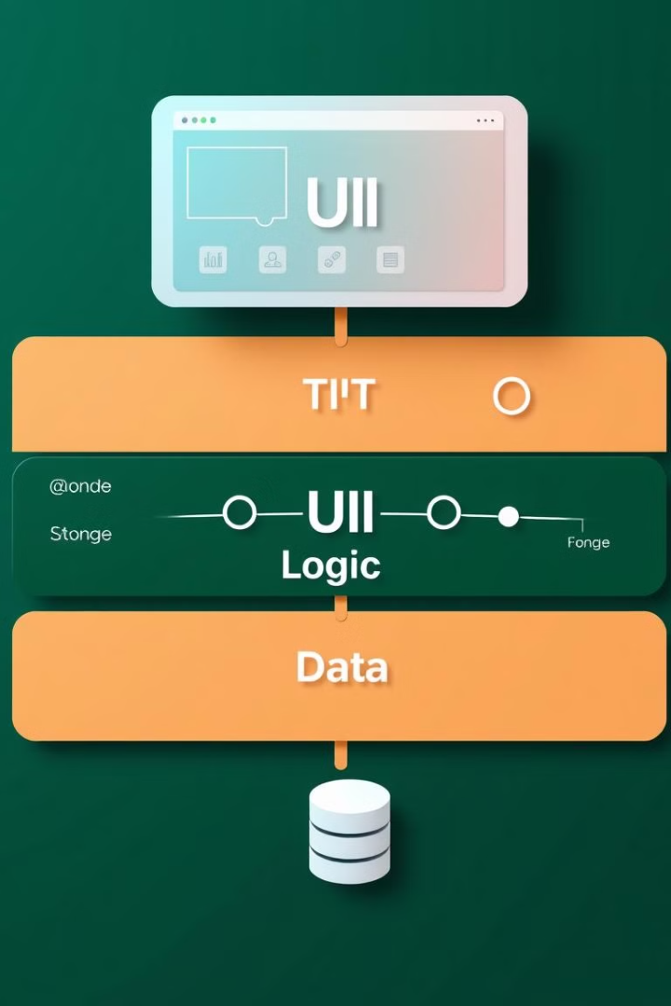



Multilayered Architecture Overview
UI Layer (ASP.NET MVC)
Handles user interactions, displaying lists, adding items, and triggering actions. It remains "dumb," showing only what the Logic Layer provides, ensuring clean and manageable UI code.
Logic Layer
The heart of the app, responsible for implementing business rules and calculations. Controls actions, like calculating the completion percentage when a book is marked as 'read'.
Data Layer
Manages all communication with the SQL database, ensuring data integrity. Shields other layers from needing to know how data is stored or retrieved.
We adopted a multilayered architecture to enhance separation of concerns, improve reusability, and ensure scalability. Each layer focuses on distinct responsibilities, promoting a cleaner and more maintainable codebase.

Slide 4


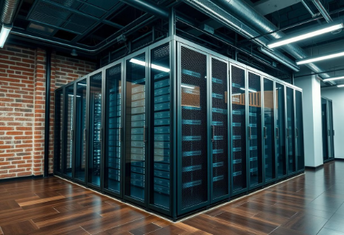
Benefits of Dependency Injection (DI)
Loosely Coupled Code
Improved Testability
Better Maintainability
Layers rely on interfaces rather than specific implementations, allowing components to be swapped with minimal changes (e.g., different database or UI framework).
Mock services can be injected into the Logic Layer, facilitating unit tests without database or UI dependencies, ensuring reliable testing processes.
All services are registered in one place, providing a clear overview of project dependencies, simplifying maintenance and updates throughout the project lifecycle.
Dependency Injection (DI) enhances code flexibility, testability, and maintainability by promoting loosely coupled components and centralized service management.

Slide 5
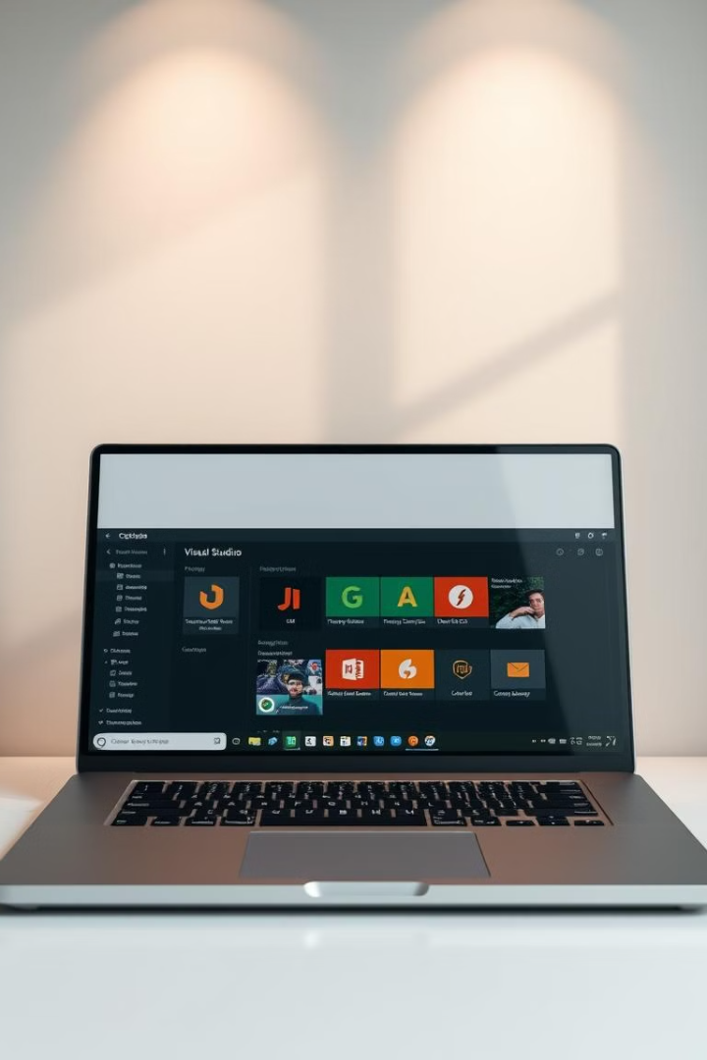
Technology Stack Overview
Visual Studio
IDE that supports ASP.NET, .NET, and SQL, with integrated Git for version control, streamlining the development workflow.
SQL Server
Chosen for its stability, ease of setup, and ability to handle complex queries, providing a robust database solution.
ASP.NET Core MVC
Framework supporting a clean separation of concerns in web applications, enhancing maintainability and scalability.
Git
Keeps track of code changes, ensuring the team can collaborate effectively without conflicts, essential for version control.

Slide 6
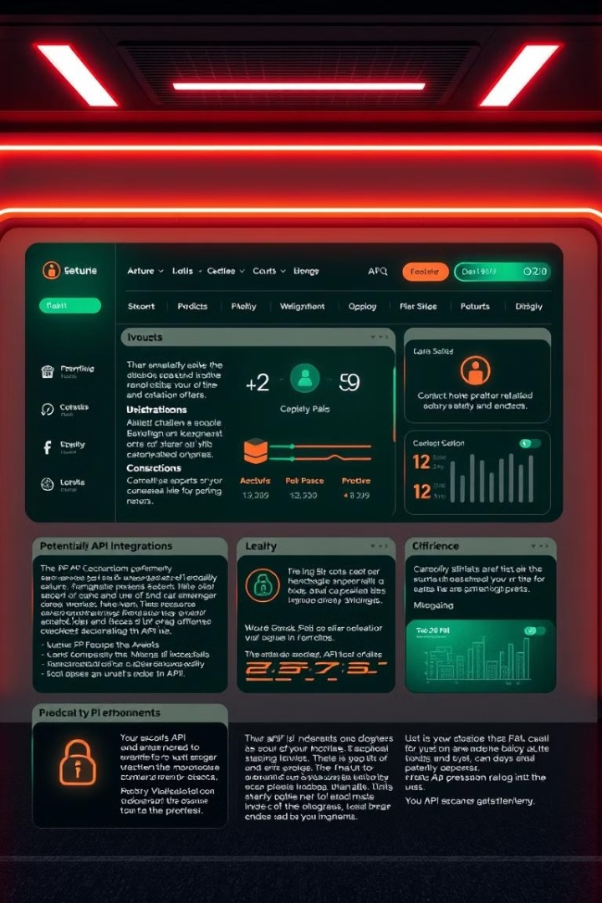
Future Enhancements and Next Steps
1
API Integration
Implement external APIs to automatically fetch movie/book data, reducing manual data entry for users and improving data accuracy.
2
Security Implementation
Add user authentication and roles (e.g., admin, user) to protect sensitive data, enhancing application security and compliance.
3
UI Improvements
Enhance the user experience with improved styling, animations, and advanced filtering/sorting options, making the application more engaging and user-friendly.

Slide 7

Conclusion: Project Achievements and Future Outlook
1
Flexible, Scalable Architecture
2
Clear Division of Responsibilities
Our multilayered setup allows easy expansion, providing a robust foundation for future development and new features.
Each teammate owned a key part of the project, ensuring progress, accountability, and focused expertise across the team.
3
Future-Proof Design
With DI, a layered architecture, and planned API/security integrations, the project is set up for continuous improvement and adaptation.
The Syntra FXT GroepsWerk 2025 project has delivered a flexible, scalable web application with clear responsibilities and future-proof design. Thank you!

